Slide 1
SPARQL
Mauricio Espinoza Mejía
mauricio.espinoza@ucuenca.edu.ec

Slide 2
Content
Main Idea of SPARQL Queries
Components of SPARQL Queries
Graph Patterns
Constraints on Solutions
Components of SPARQL Queries: Other feautures
Solution Modifiers
SPARQL 1.1

Slide 3
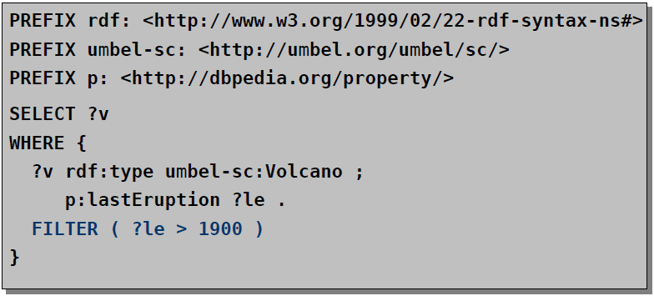
Constraints on Solutions
Syntax: Keyword FILTER followed by filter expression
Filter expressions contain operators and functions
Operators and functions operate on RDF terms

Slide 4
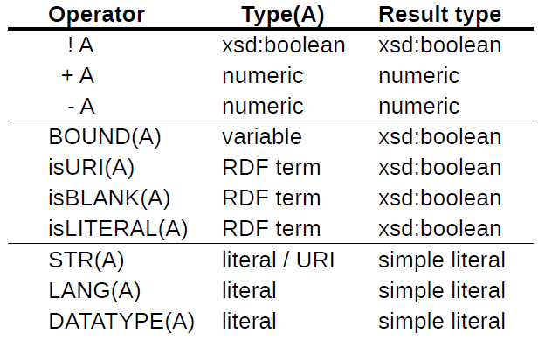
Unary Operators in Constraints

Slide 5
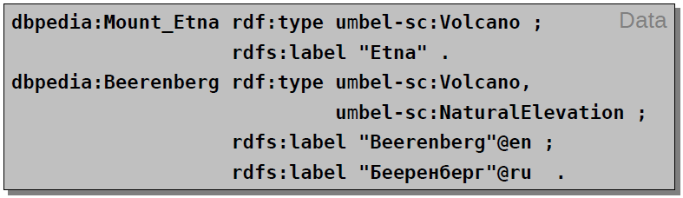
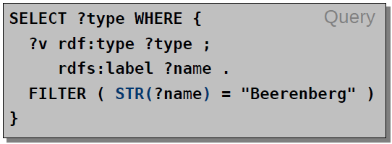
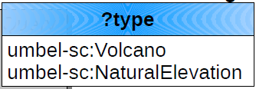
Constraints (Example)
Question: List all types of the volcano called “Beerenberg”

Slide 6
Constraints (Further Operators)
Binary operators:
Logical connectives && and || for xsd:boolean
Comparison operators =, !=, <, >, <=, and >= for numeric datatypes, xsd:dateTime, xsd:string, and xsd:boolean
Comparison operators = and != for other datatypes
Arithmetic operators +, -, *, and / for numeric datatypes
Furthermore:
REGEX(String,Pattern) or REGEX(String,Pattern,Flags)
sameTERM(A,B)
langMATCHES(A,B)

Slide 7
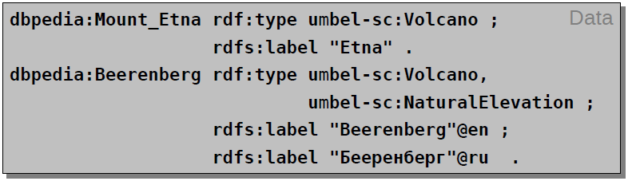
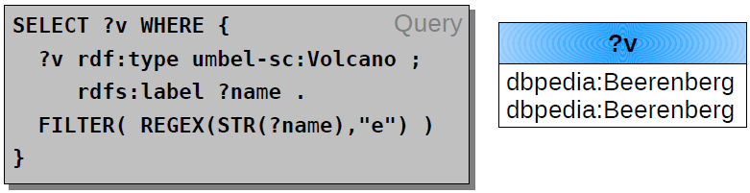
Constraints (Example)
Question: What volcanos have an “e” in their name?

Slide 8
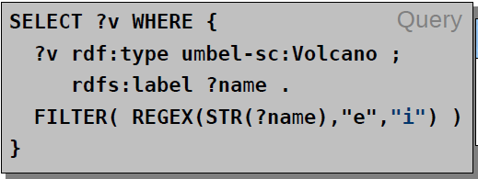
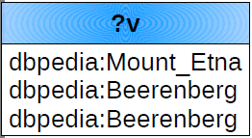
Constraints (Example)
Question: What volcanos have an “e” in their name?

Slide 9
Content
Main Idea of SPARQL Queries
Components of SPARQL Queries
Graph Patterns
Constraints on Solutions
Components of SPARQL Queries: Other feautures
Solution Modifiers
SPARQL 1.1

Slide 10
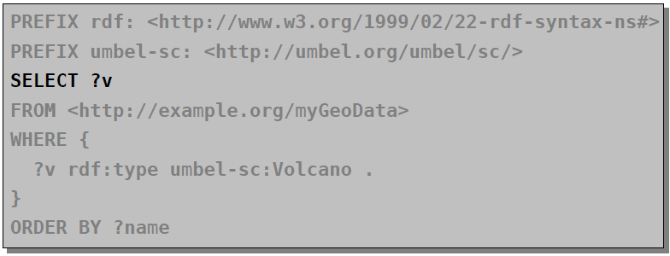
Components of SPARQL Queries
Result form specification:
SELECT, DESCRIBE, CONSTRUCT, or ASK

Slide 11
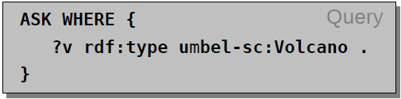
Result Forms
SELECT
Result: sequence of solutions (i.e. sets of variable bindings)
Selected variables separated by space (not by comma!)
Asterisk character (“*”) selects all variables in the pattern
ASK
Check whether there is at least one result
Result: true or false
Example: Do we have data about volcanos?

Slide 12
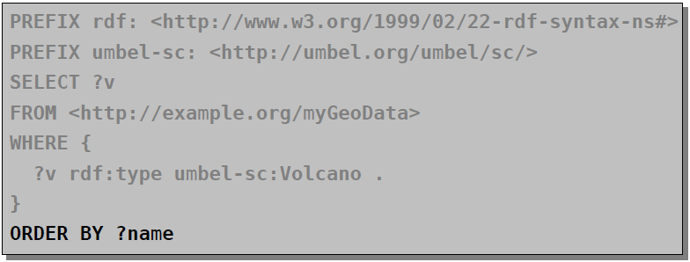
Components of SPARQL Queries
Solution modifiers:
Only for SELECT queries
Modify the result set as a whole (not single solutions)
Keywords: DISTINCT, ORDER BY, LIMIT, and OFFSET

Slide 13
Content
Main Idea of SPARQL Queries
Components of SPARQL Queries
Graph Patterns
Constraints on Solutions
Components of SPARQL Queries: Other feautures
Solution Modifiers
SPARQL 1.1

Slide 14
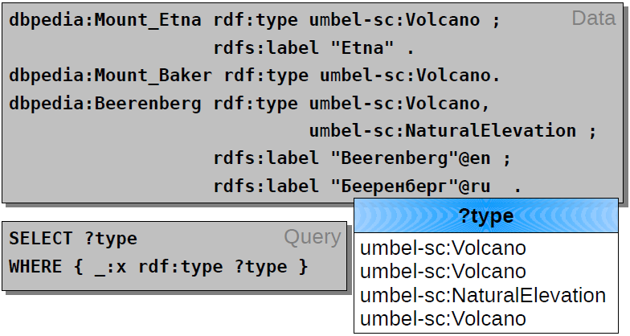
Solution Modifiers
DISTINCT removes duplicates from the result set

Slide 15
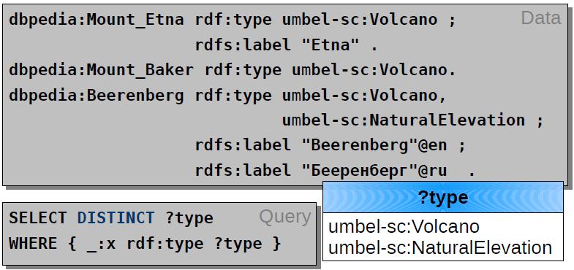
Solution Modifiers
DISTINCT removes duplicates from the result set

Slide 16
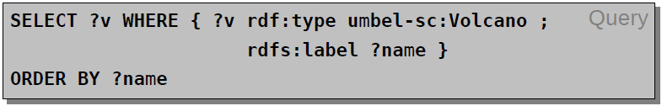
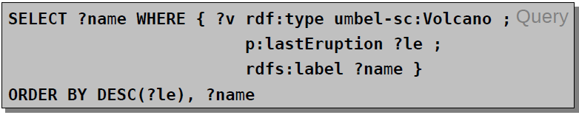
Solution Modifiers
ORDER BY orders the results
How do we order different kinds of elements?
unbound variable < blank node < URI < literal
ASC for ascending (default) and DESC for descending

Slide 17
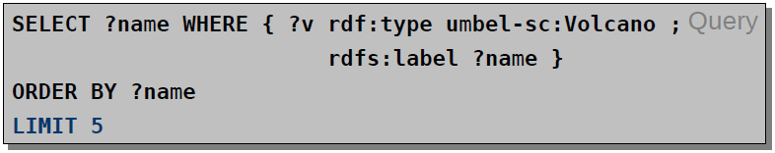
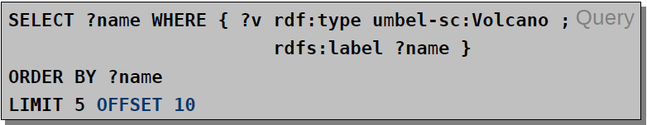
Solution Modifiers
LIMIT – limits the number of results
OFFSET – position/index of the first reported results
Order of result should be predictable (i.e. combine with ORDER BY)

Slide 18
Content
Main Idea of SPARQL Queries
Components of SPARQL Queries
Graph Patterns
Constraints on Solutions
Components of SPARQL Queries: Other feautures
Solution Modifiers
SPARQL 1.1

Slide 19
SPARQL 1.1
New features of SPARQL 1.1 Query:
Aggregate functions (e.g. COUNT, SUM, AVG)
Subqueries
Negation (EXISTS, NOT EXISTS, MINUS)
Basic query federation (SERVICE, BINDINGS)
….
SPARQL 1.1 Update:
Graph update (INSERT DATA, DELETE DATA, INSERT, DELETE, DELETE WHERE, LOAD, CLEAR)
Graph management (CREATE, DROP, COPY, MOVE, ADD)

Slide 20
Práctica 15

Slide 21

Questions?

